Slide 1

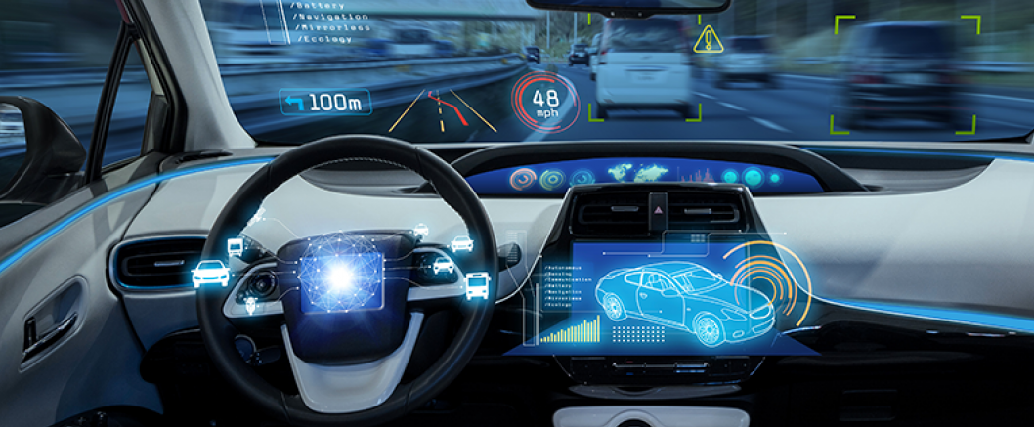
Autonomous Car following: Prediction of inter-vehicle distance
Group 5

Slide 2

Agenda
Autonomous vehicles
Problem statement
Previous Research
Source of dataset and EDA
Project Assumptions
Tools required
Project Update
Foreseen challenges in the project
Proposed project outcome

Slide 3
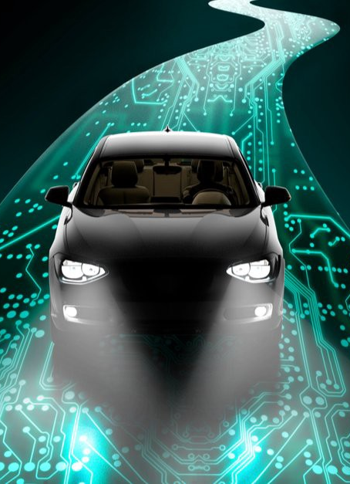
Autonomous Vehicles
Autonomous cars, also known as self-driving cars, are vehicles that can operate without direct human input. These cars use a combination of sensors, cameras, radar, and other technologies to detect their surroundings and make decisions based on that information.
Autonomous cars can be categorized into different levels of autonomy based on the extent of human input required. The six levels of autonomy are:
Level 0: No automation - The driver has full control of the vehicle at all times.
Level 1: Driver assistance - The car can assist the driver with either steering or accelerating/decelerating, but not at the same time.
Level 2: Partial automation - The car can assist the driver with both steering and accelerating/decelerating simultaneously, but the driver must remain engaged and ready to take control at any time.
Level 3: Conditional automation - The car can operate without driver input under certain conditions, but the driver must be ready to take control when requested by the car.
Level 4: High automation - The car can operate without driver input under most conditions, but the driver may need to take control in certain situations.
Level 5: Full automation - The car can operate without driver input under all conditions and can perform all driving tasks.

Slide 4
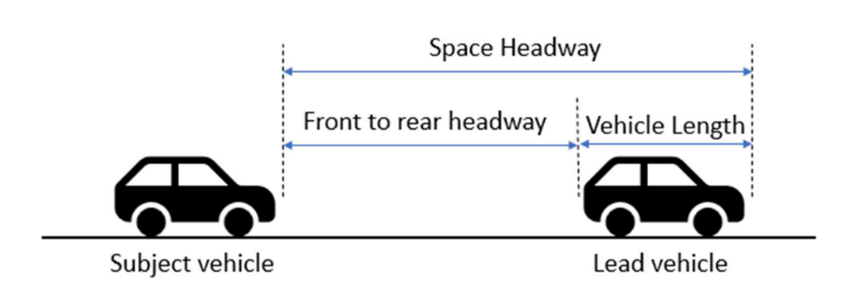
Problem statement
Cameras, LiDAR, and Radar Sensors perform inaccurately during harsh weather conditions
Most car-following models are based off assumptions and not data based resulting biases in real life scenarios
Safety concerns around unknown intentions of other road users, communications between vehicles and road infrastructures.

Slide 5

Project Objectives
The main objectives of this project work
Predict the inter-vehicle distance between two autonomous cars.
To minimize the error in this prediction (inter-vehicle distance) using RNN.

Slide 6
Past Research work
Abdelmoghit et al proposed an algorithm based on stereo vision for distance measurement using only web cameras, and the calculation formula contains simple terms based on web cameras criteria obtained by manual measurement
Li et al (2022) utilized the following driving characteristics from real-world microscopic driving data and combines them with Deep Reinforcement Learning to realize autonomous following decision control. In their model, they proposed an agent-environment interaction model of an autonomous car-following decision-making model to provide automatic driving that is safe, effective, and comfortable
Gao et al (2019) developed a learning-based algorithm to predict the CUV’s lane change intention and a car-following controller is designed by incorporating the lane-change intentions of the CUV. The estimation of CUV lane change intentions and the autonomous vehicle safety control strategy in a common and high-risk mixed traffic scenario. The CUV cuts into the lanes of adjacent autonomous vehicles in a non-cooperative manner. The libsvm toolbox in the MATLAB environment was used to model the driver’s lane-changing behavior and select the radial basis function as the kernel function of the SVM classifier.

Slide 7
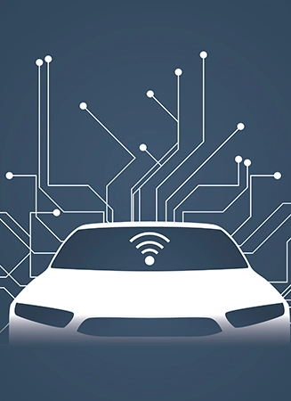
Dataset Source
Researchers for the Next Generation Simulation (NGSIM) program collected detailed vehicle trajectory data on the above-specified freeway segments of US-101 and I-80 as well as the specified arterial segments of Lankershim Boulevard and Peachtree Street. Data were collected through a network of synchronized digital video cameras. NGVIDEO, a customized software application developed for the NGSIM program, transcribed the vehicle trajectory data from the videos.
Link:
https://github.com/Shuoxuan/NGSIM_Cleaned_Dataset

Slide 8
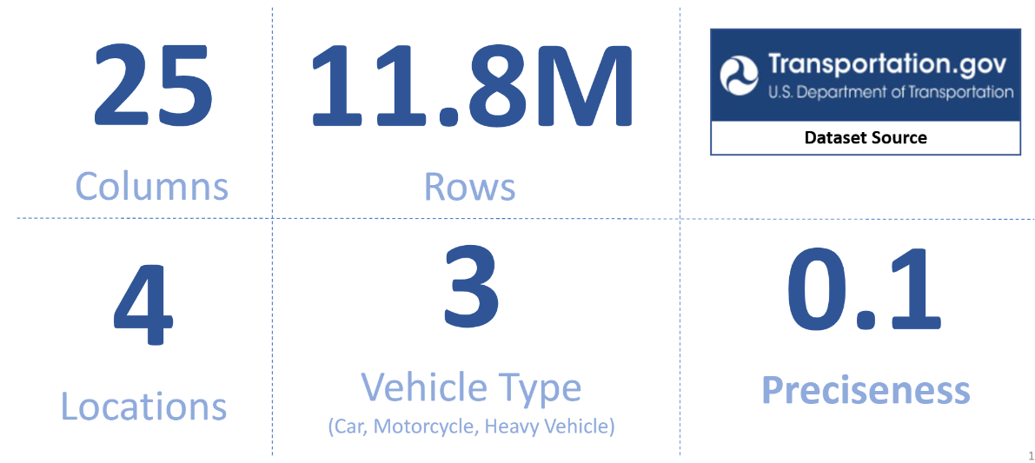
Exploratory Data Analysis
a. The dataset used in this project is called Next Generation Simulation (NGSIM) and it is publicly available on the U.S. Department of Transportation website.
b. The NGSIM dataset consists of 25 columns and 11.8 million rows of vehicle trajectory data which was captured using a network of synchronized digital video cameras on 4 different locations (US 101, I-80).
c. The data contains the location of a vehicle at every one-tenth of a second, which gives the exact position of each vehicle relative to other vehicles.

Slide 9
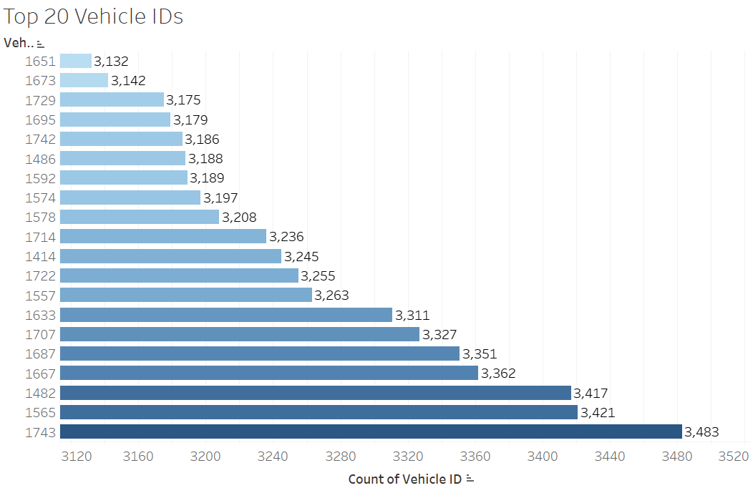
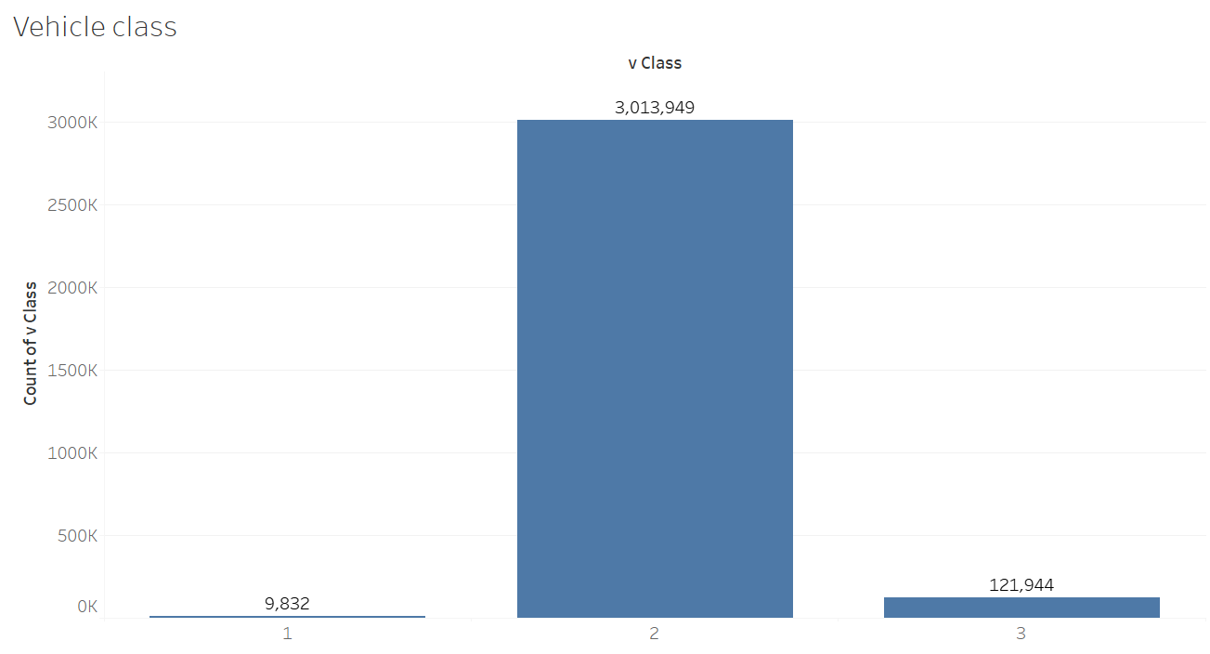
Exploratory Data Analysis

Slide 10





Our Assumption based on Autonomous following Car
The subject vehicle and the lead vehicle's bumper-to-bumper separation shouldn't be any closer than a safe distance.
Gentle Braking when conditions are normal. When conditions are crucial, deceleration surpasses what is comfortable, and once the threat has been removed, comfortable braking is used.
It should be easy to switch between driving modes, such as from acceleration to car-following mode.

Slide 11
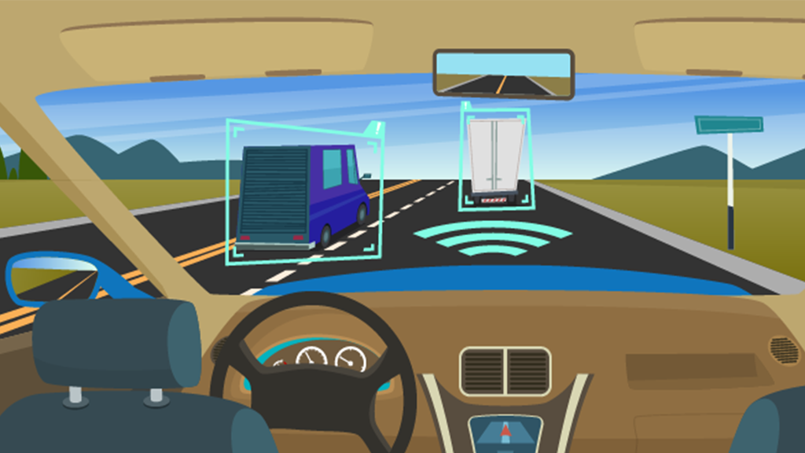
Skill required for project work
1. Python: Numpy, Pandas, Scikit learn, Tensor flow, Matplotlib, Streamlit, and Seaborn
2. Neural Networks: CNN , KNN and RNN
3. Data Cleaning/Smoothing
4. Data Visualization: Tableau and Dashboard for visualization
5. Microsoft Azure
6. Modal sensing

Slide 12
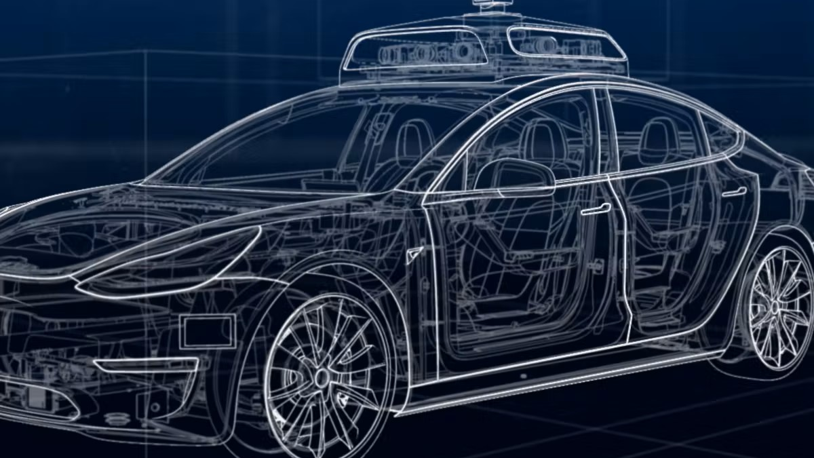
Current update
Add two new columns: "dataset" (containing names like "i80" or "us101") and "period" (e.g., "4:00 - 4:15 pm").
Combine all the i80 and us101 data files separately .
Filter the data to include only non-lane-changing vehicle pairs where the unique lane ID for a given vehicle ID is equal to 1.
Treat the us101 data as the training set and the i80 data as the test set.
Train a random forest model using the us101 training set.
Test the trained model on the i80 test set.
Verify the accuracy of the model's predictions based on the correct equations of motion calculations.

Slide 13
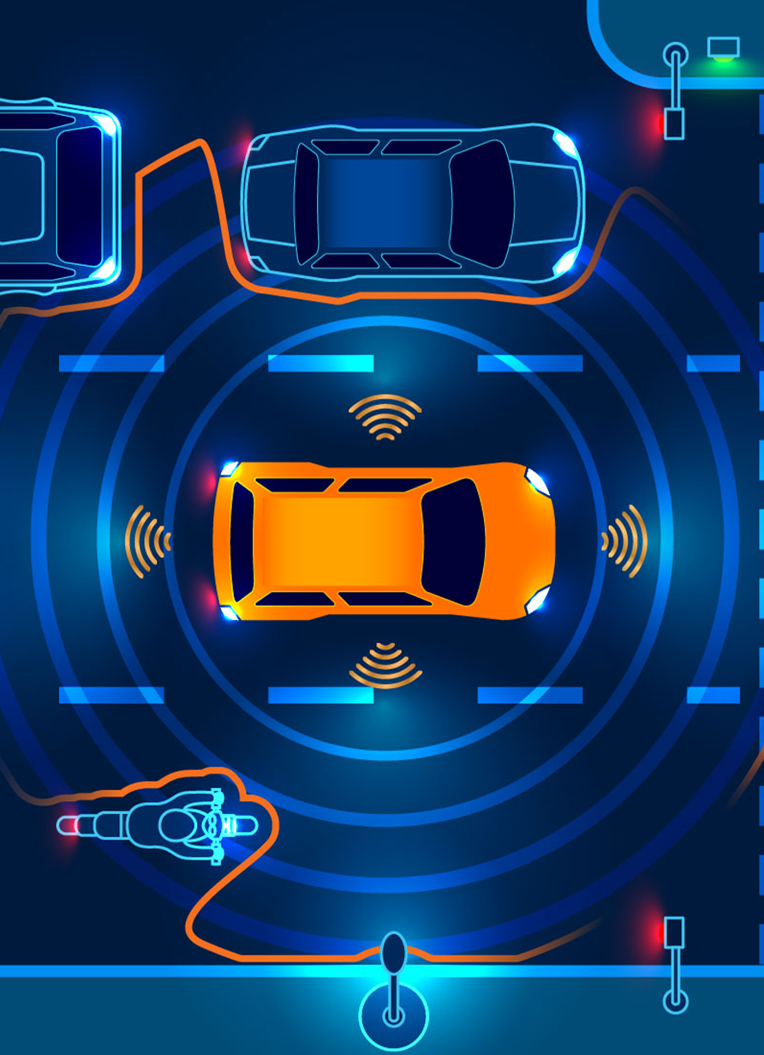
Foreseen Challenges with project
Detecting surroundings vehicles information accurately (e.g. distance between vehicles) in real time is very important.
Algorithm to calculate the inter-vehicle distance
Data partitioning

